Slide 1
Senior Design: Team sdmay18-14
Mobile and Web Timecard
Nicholas Flege
Andrew Hoelscher
Connor McCann
Thomas Reins
Cole Stephan
Jason Thomas
Christian Wesseler
Notes:
Tommy

Slide 2
Overview
Problem Statement
Functional Requirements
Non-Functional Requirements
Market Survey
Sketches/Designs
Software Platforms
Backend Development
Database Development
iOS Development
Android Development
Web Development
Testing
Current Functions
Requirements Standing
Notes:
Tommy

Slide 3
Problem Statement
Genova and other companies contract employees for specific projects. The time spent working is recorded in a timecard in order to compensate with pay rates that correspond to each project.
Genova’s old timecard broke due to a separate software update. Since then, they have been in need of a timecard app that their company can use.
This problem may not be unique to Genova. As such, the timecard system we developed will be built upon and sold by Genova to other companies needing similar solutions.
Notes:
Tommy

Slide 4
Functional Requirements
Timecard software that works on iOS, Android, and web
Display relevant information to user about timecard
Past timecard summaries for Employee
Team/Department/Company time summaries for Managers
Software can integrate with existing accounting systems (Dynamics) at Genova
Different functions for different levels of users
Employee, Manager, Admin
Works for different timecards
timecard periods of 1-week, 2-week, 1-month, etc...
Does the work week start on Monday, Sunday, etc...?
Notes:
Jason

Slide 5
Non-Functional Requirements
Simple to use
Similar design and function between mobile and web platforms
Secure database and communications
Sensitive business information is stored and sent
Scalable
Any number of employees
Any business
Notes:
Jason

Slide 6
Market Survey
There are already existing timecard programs
E.g. Microsoft, T-Sheets
Most are complex, don’t have multiplatform support, or are not free to use
Not flexible - have a set weekly timecard start/end days and weekly periods
Genova wants control over application
Be able to change specific parts functionality for other customers
Rather have an in-house application rather than pay someone else
Notes:
Connor

Slide 7
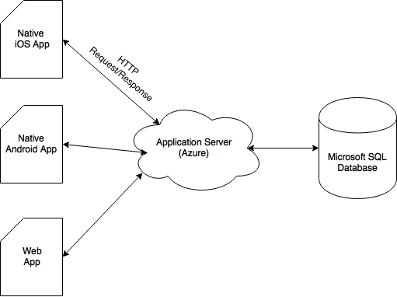
Conceptual Sketch
Notes:
Christian

Slide 8
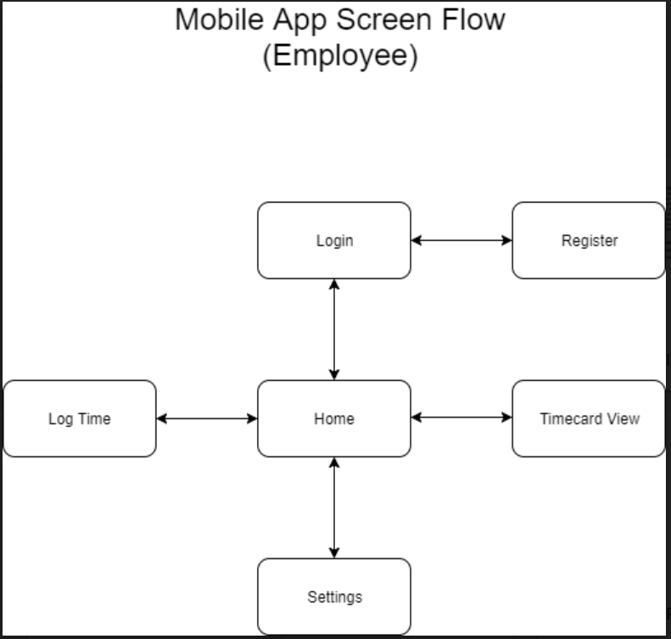
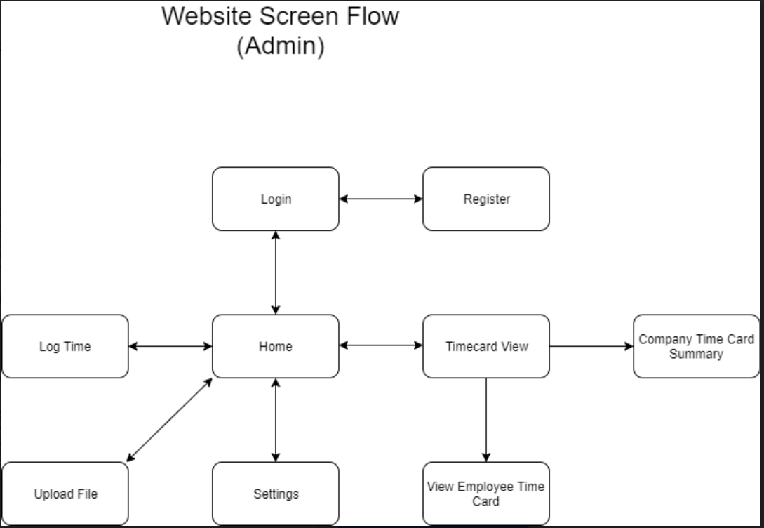
UI Flows
Notes:
Christian

Slide 9
Software Platforms
Microsoft Azure to host servers
Programming Languages
Java, for Android development
Swift, for iOS development
C# for backend server (.NET)
Javascript, JQuery, Bootstrap website development
Tools
Xcode
Android Studio
Visual Studio
PostMan
Notes:
Cole

Slide 10
Backend Development
API endpoints for login, user registration, and getting projects and tasks, and for getting and creating user time data
Uses JSON web tokens for user authentication
Design based on MVC Model
Notes:
Cole

Slide 11
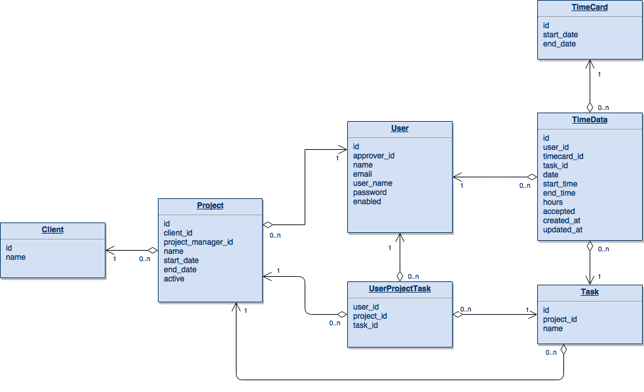
Database Development
Created with .Net Core Code First
Deployed on Azure
Database Migrations
Notes:
Nick

Slide 12
iOS Development
Swift
MVC architecture
JSON Web Token Authentication
Apple’s Encrypted Keychain
Networking
Singleton design pattern
Codable protocol
Login/Register, View Timecard, Submit Time
Notes:
Nick

Slide 13
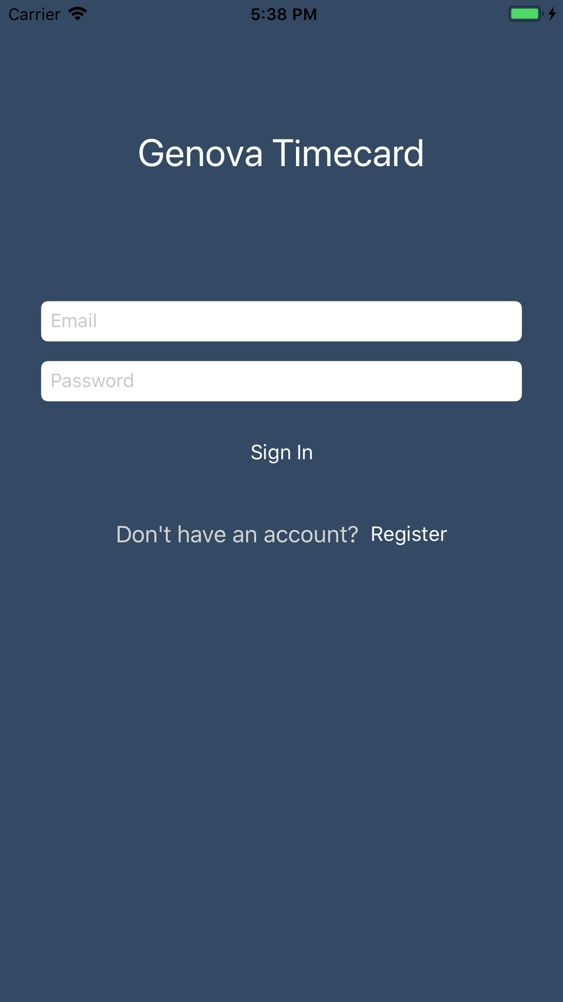
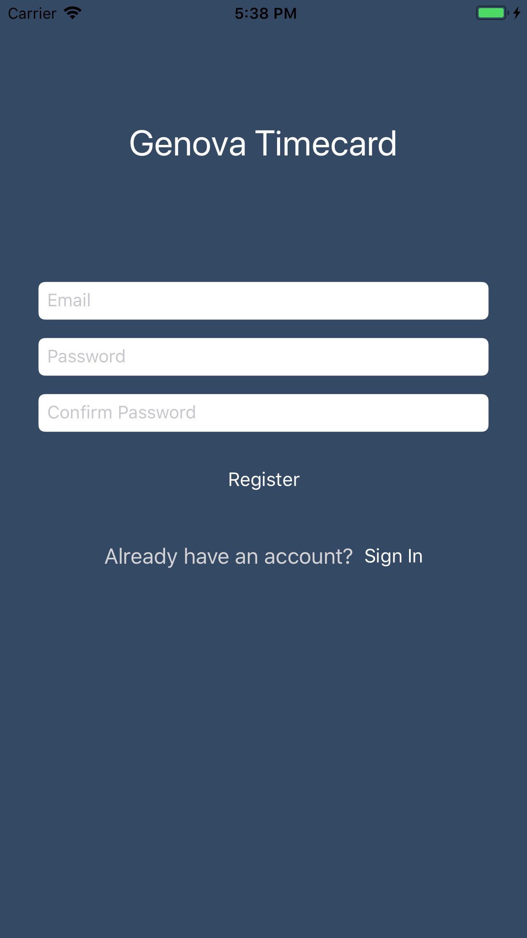
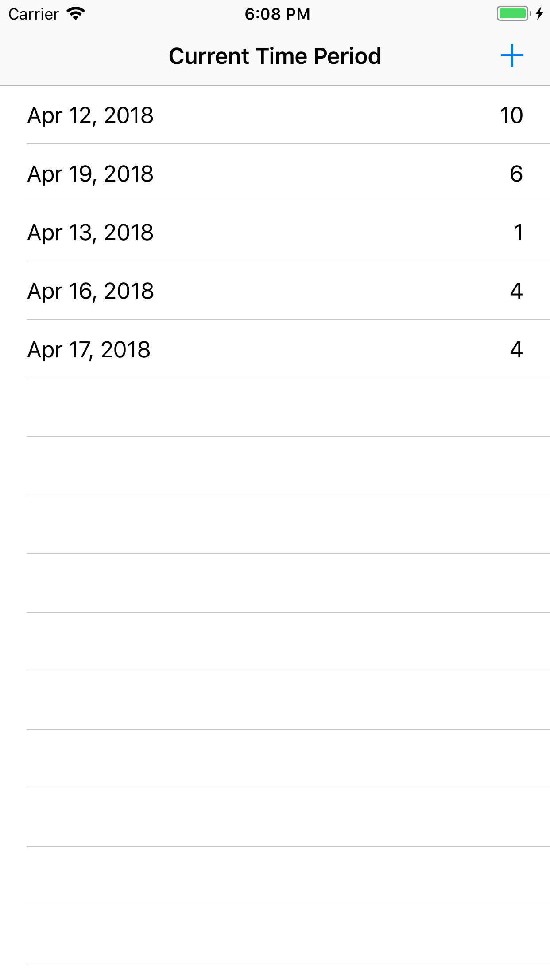
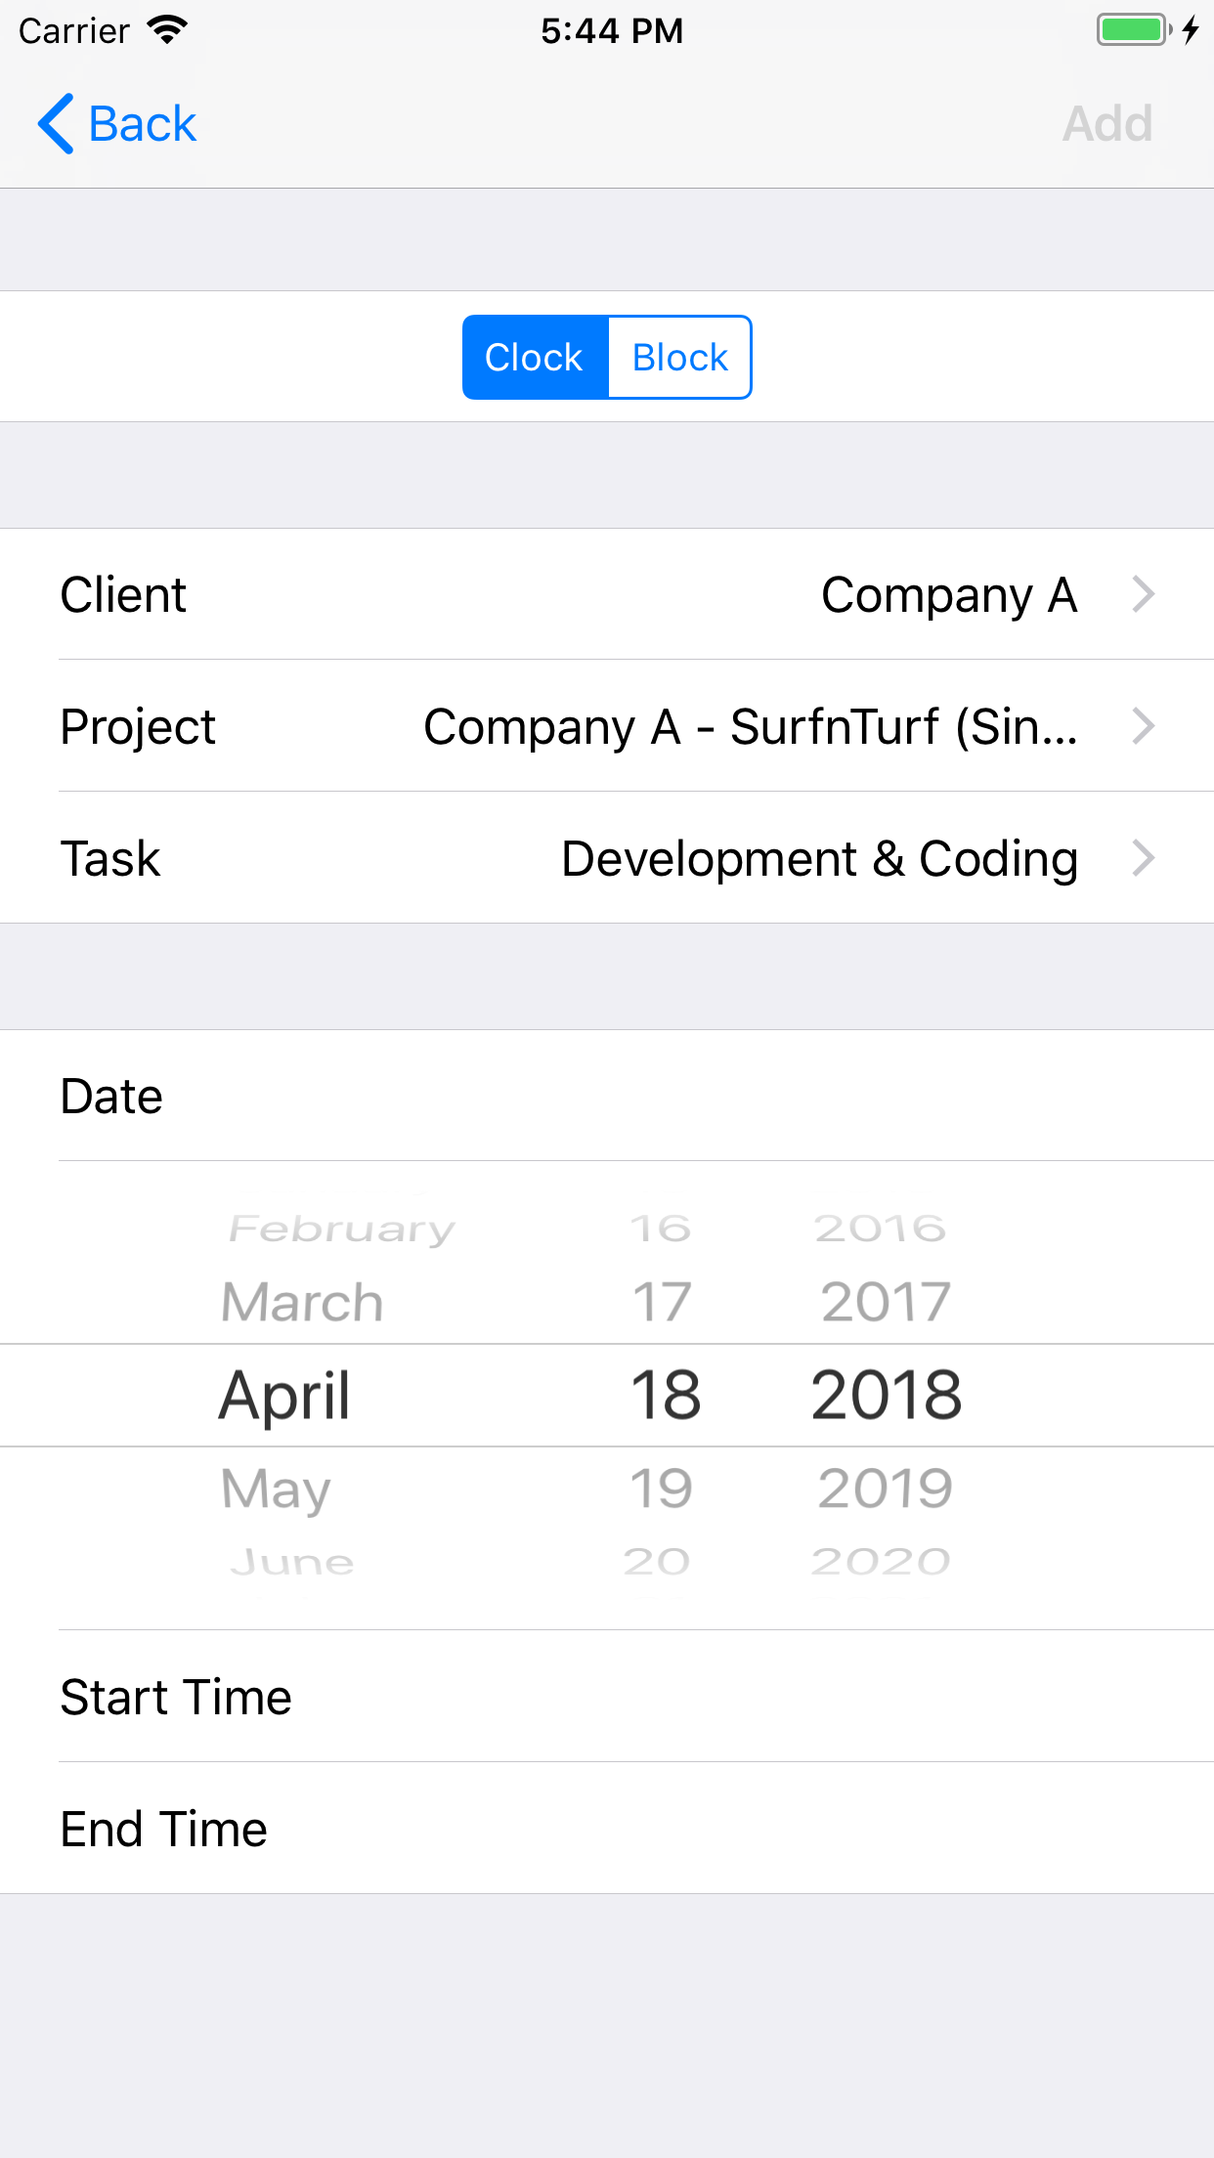
iOS Screenshots

Slide 14
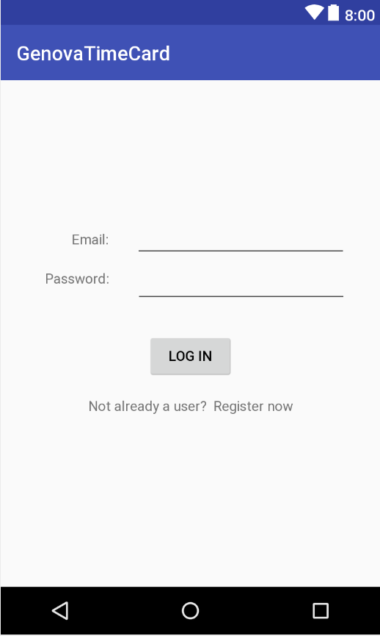
Android Development
What was done
Login, Register Users, Get Projects
Kotlin vs Java - start of semester debate
iOS lead development off the start
Android followed suit
Usually about 2 weeks behind
Development split towards end of semester
Christian assigned to help out
Rework at end of semester
Notes:
Connor

Slide 15
Web Development
Began using ASP .NET Core
Meshes well with Microsoft development environment
We had no experience, overly complicated
Switched to Javascript, JQuery, Bootstrap combination
Also no experience
Quickly made progress, tons of documentation, simpler
Login/Registration Page, Project List Page, Timecard Page
Notes:
Tommy
I don’t think we should say “less documentation” for .NET Core

Slide 16
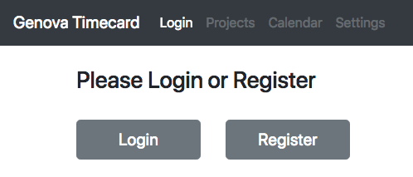
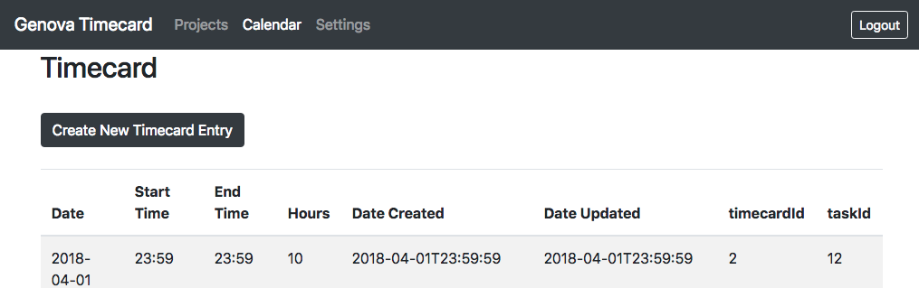
Web Screenshots
Notes:
Tommy
I don’t think we should say “less documentation” for .NET Core

Slide 17
Testing
Endpoints
Postman
Authentication
UI
Automated Swift UI tests
Android Studio XML viewer
Database
Check local database for data
Notes:
Andrew

Slide 18
Current Functions
User can login and logout
New users can create accounts
Users can create a new timecard
View submitted times for current timecard
Users can record time for specific client, project, and task
Block and start/end time formats.
Users can submit timecard to manager for approval
Users can view reports of previous timecards
Administrator/Manager Functions
Notes:
Andrew

Slide 19
Requirements Standing
✔️ Timecard software that works on iOS, Android, and web
✔️ Display relevant information to user about timecard
✔️ Past timecard summaries for Employee
❌ Team/Department/Company time summaries for Managers
✔️ Software can integrate with existing accounting systems (Dynamics) at Genova
❌ Different functions for different levels of users
❌ Employee, Manager, Admin
✔️ Works for different timecards
❌ Timecard periods of 1-week, 2-week, 1-month, etc...
❌ Does the work week start on Monday, Sunday, etc...?
Notes:
Tommy
WORK WILL CONTINUE

Slide 20
We will take this time to answer any questions.
Notes:
Have you ever heard the story of Darth Plagius the wise?

