Slide 1
Senior Design: Team sdmay18-14
Mobile and Web Timecard
Andrew Hoelscher
Christian Wesseler
Cole Stephan
Connor McCann
Jason Thomas
Nicholas Flege
Thomas Reins
Notes:
Jason

Slide 2
Overview
Project Plan
Problem Statement
Conceptual Sketch
Functional Requirements
Non-Functional Requirements
Constraints and Considerations
Market Survey
Potential Risks and Mitigation
Resource/Cost Estimate
Project Milestones & Schedule
System Design
Functional Decomposition
Detailed Design/UI Flows
Software Platforms
Test Plan
Project Standing
Current Status
Team Member Responsibilities
Plan for Spring Semester
Notes:
Jason

Slide 3
Project Plan
Notes:
Jason

Slide 4
Problem Statement
Genova and other companies contract employees for specific projects. The time spent working is recorded in a timecard in order to compensate with pay rates that correspond to each project.
Genova’s old timecard broke due to a separate software update. Since then, they have been in need of a timecard app that their company can use.
This problem may not be unique to Genova. As such, the timecard system we develop will be sold by Genova to other companies needing similar solutions.
Notes:
Jason

Slide 5
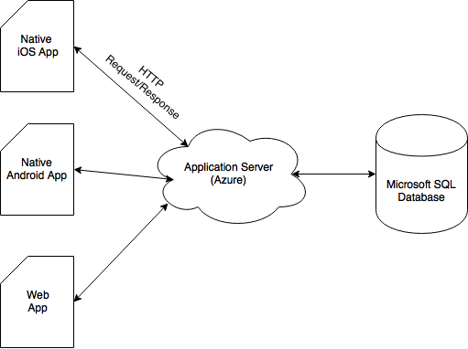
Conceptual Sketch
Notes:
Jason

Slide 6
Functional Requirements
Time card software that works on iOS, Android, and web
Software can integrate with existing accounting systems (Dynamics) at Genova
Different functions for different levels of users
Employee, Manager, Admin
Works for different time cards
Time card periods of 1-week, 2-week, 1-month, etc...
Does the work week start on Monday, Sunday, etc...?
Display relevant information to user about time card
Past time card summaries for Employee
Team/Department/Company time summaries for Managers
Notes:
Cole

Slide 7
Non-Functional Requirements
Simple to use
Similar design and function between mobile and web platforms
Secure database and communications
Sensitive business information is stored and sent
Scalable
Any number of employees
Any business
Notes:
Cole

Slide 8
Constraints and Considerations
Design should be similar to Genova’s previous time card
Software needs to be reliable and maintainable
iOS development requires Apple hardware to develop
Visual Studio does not work on native Mac computers
Ex: Issues with Azure
Private information that is used during development must be kept confidential and secure
Notes:
Cole

Slide 9
Market Survey
There are already existing time card programs
E.g. Microsoft, T-Sheets
Most are complex, don’t have multiplatform support, or are not free to use
Not flexible - have a set weekly time card start/end days and weekly periods
Notes:
Connor

Slide 10
Potential Risks and Mitigation
Database security
The time card will have access to private information, including data on other companies.
Testing application with generated test data before integrating with existing systems.
Financial responsibility
Billing for projects is based on the results of the timecard. Inaccurate information could lead to profit loss, or overcharging.
Comparison testing will be done between Genova’s current systems, and the new timecard to ensure a seamless transition
Notes:
Connor

Slide 11
Resource/Cost Estimate
The biggest cost for this project is hosting our servers on Microsoft Azure
Server Type (1 Instance) | Cost per Month ($) | Cost for 12 Months ($)
Windows Virtual Machine | 102.48 | 1229.76
SQL Database | 4.91 | 58.92
Total | 107.39 | 1228.68
Notes:
Connor

Slide 12
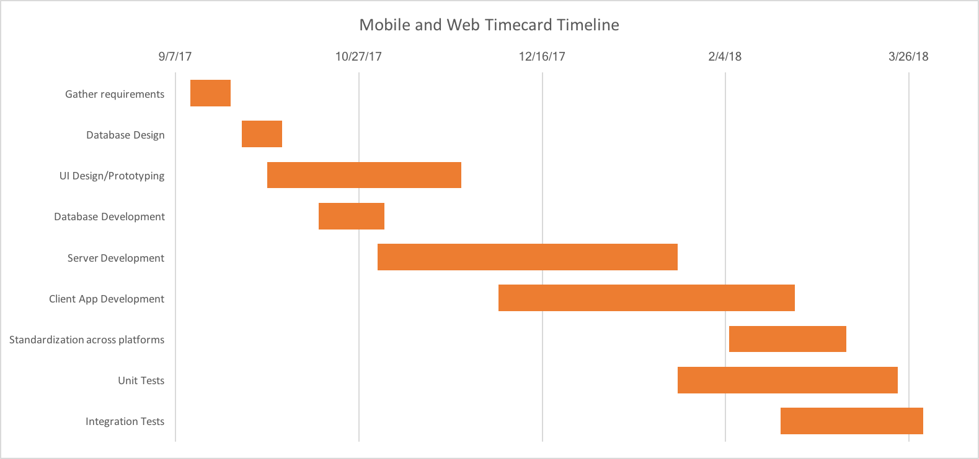
Project Milestones & Schedule
Notes:
Nick

Slide 13
System Design
Notes:
Nick

Slide 14
Functional Decomposition
Web and Mobile Specifications
User can login and logout
New users can create accounts
Users can create a new time card
Users can record time for specific client, project, and task
Block and start/end time formats.
Users can submit timecard to manager for approval
Users can view reports of previous timecards
Notes:
Nick

Slide 15
Functional Decomposition
Web-specific Specifications
Managers can review and approve their direct reports’ timecards
Admin can view summaries of all users
Admin can create/edit/complete timecard for another user
Admin can submit timecards for given pay period to accounting system
Notes:
Nick

Slide 16
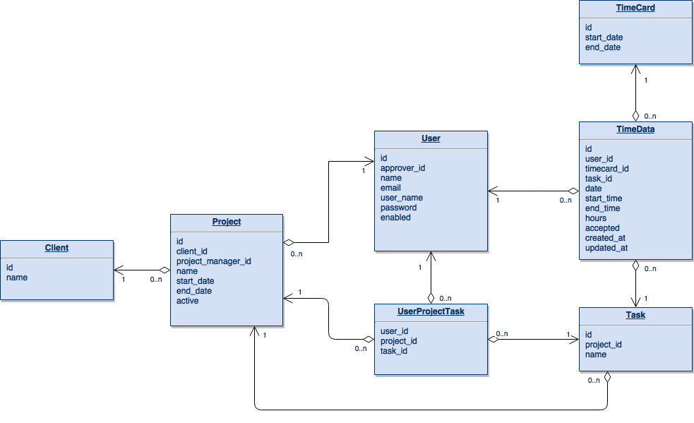
Database Design
Notes:
Tommy - go into detail about the design

Slide 17
Notes:
Tommy
Timecard - pay period.
TimeData - the punches.
UserProjectTask - combo

Slide 18
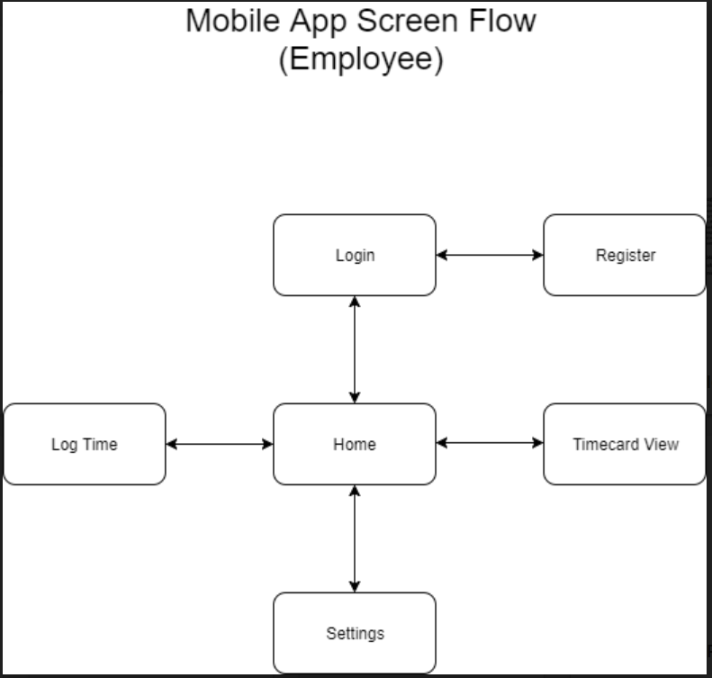
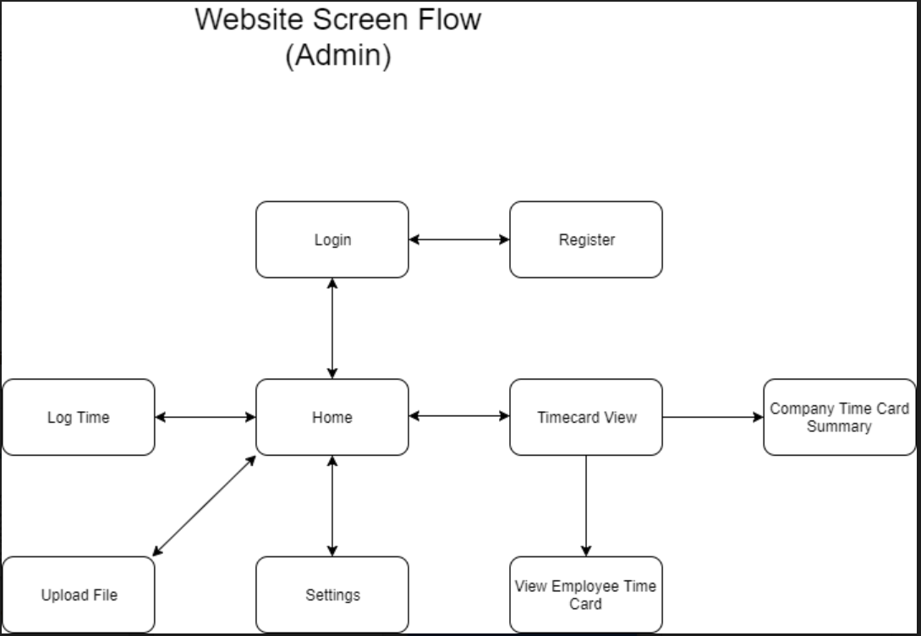
Detailed Design/UI Flows
Notes:
Tommy

Slide 19
Software Platforms
Microsoft Azure to host servers
Programming Languages
Java, for Android development
Swift, for iOS development
C# for server communication (.NET)
Javascript/Angular for website development
Tools
Rally
Xcode
Android Studio
Visual Studio
Notes:
Christian

Slide 20
Test Plan
Product testing will be performed using test data provided by Genova
No testing software has been selected currently to process project’s correctness
Testing will be done in accordance with Genova’s expectations, utilizing their preferred software
Unit tests on iOS through Xcode’s testing framework
Notes:
Christian

Slide 21
Project Standing

Slide 22
Current Status
User Stories
Azure Environment
Database “Dummy Data”
Rough Design
Web Framework Selected
Notes:
Andrew

Slide 23
Team Member Responsibilities
Andrew Hoelscher - Software Testing
Christian Wesseler - Design and Documentation
Cole Stephan - Server Management
Connor McCann - Android Development
Jason Thomas - Team Administrator
Nicholas Flege - iOS Development
Thomas Reins - Web Development
Notes:
Andrew

Slide 24
Plan for Spring Semester
Finalize backend server
Set up web-based timecard
Develop android and iOS timecard variants
Test timecard on test data
Integrate into Genova systems
Develop support for external companies to use with their databases
Test timecard with external company test data
Product release
Notes:
Andrew

Slide 25
Summary
Project Plan
Problem Statement
Conceptual Sketch
Functional Requirements
Non-Functional Requirements
Constraints and Considerations
Market Survey
Potential Risks and Mitigation
Resource/Cost Estimate
Project Milestones & Schedule
System Design
Functional Decomposition
Detailed Design/UI Flows
Software Platforms
Test Plan
Project Standing
Current Status
Team Member Responsibilities
Plan for Spring Semester
Notes:
Jason

Slide 26
We will take this time to answer any questions.

Slide 27
Ok, that’s enough questions.

